Slide 1

DEPARTMENT OF COMPUTER SCIENCE AND ENGINEERING
INTERDISCIPLINARY PROJECT
Sathyabama Hostels Management System
PROJECT STUDENT
CH.SURYA PRAKASH, 43111163

Slide 2
AGENDA
Abstract
Existing system
Proposed System
Advantagrs
Disadvantages
Hardware Requirements
Software Requirements
Modules
Modules Description
Sample OutPut(screenShort)
Conclusion

Slide 3
Proposed System
Proposed System: Centralized Digital Management

Slide 4
Abstract
The Sathyabama Hostels Management System is a robust web-based application designed to streamline and automate all aspects of campus accommodation, from student registration and room allocation to maintenance and fee management.

Slide 5
Existing system
The current manual or fragmented system faces significant drawbacks that impact operational efficiency and user experience.
High Overhead & Errors
Reliance on physical records, spreadsheets, and paper forms leads to frequent data entry errors and slow processing times for applications and allocations.
Poor Transparency
Students lack real-time visibility into room availability, fee status, and maintenance request progress, leading to frustration.

Slide 6
Proposed System
Proposed System: Centralized Digital Management
Admin Login
Full control over system configurations, room inventory, allocation rules, and financial reporting.
Student Login
Personal dashboard to view room status, make payments, submit maintenance requests, and check notices.
Hostel & Room Categorization
Differentiated management for Boys' and Girls' Hostels, including distinct categories like Co-living and Premium rooms.

Slide 7
Advantagrs
Increased Efficiency
Automated processes reduce administrative workload by up to 60%, speeding up check-ins, allocations, and fee collection.
Enhanced Security
Data is centralized and secured, minimizing the risk of data loss and ensuring accurate record-keeping for audit purposes.
Improved User Experience
Students benefit from 24/7 access to information and a simplified process for essential tasks, boosting satisfaction.

Slide 8
Disadvantages
Implementing any new system carries inherent challenges that must be addressed proactively.
Initial setup and data migration can be complex and time-consuming.
Requires adequate training for all staff to effectively utilize new functionalities.
Potential reliance on consistent internet connectivity for seamless operation.

Slide 9
Hardware Requirements
Server
High-performance dedicated server (minimum 16GB RAM, Quad-Core Processor) for the database and application.
Client Machines
Standard desktop/laptop with modern web browsers for administrative and student access.
Network
Reliable high-speed LAN/WAN connectivity for all users within the campus.

Slide 10
Software Requirements
Operating System
Linux (Ubuntu Server) or Windows Server for application hosting.
Database
PostgreSQL or MySQL for robust data storage and retrieval.
Development Tools
Java Framework (e.g., Laravel, Django, Spring Boot) for the backend, and HTML5, CSS3, JavaScript for the frontend.

Slide 11
Modules
User Management & Authentication:
Handles sign-up, login (Student/Admin), password recovery, and role-based access control to ensure security.
Room & Inventory Management
Manages hostel categories (Boys/Girls, Premium, Co-living), room capacity, and real-time occupancy status.
Fee & Financial Tracking
Automates fee structure application, online payment integration, receipt generation, and outstanding balance tracking.
Maintenance & Complaints
A portal for students to submit maintenance requests and track resolution status; facilitates admin task assignment

Slide 12
Modules Description
Co-living Hostels
Modern, shared living spaces emphasizing community and integrated amenities (e.g., shared lounges, higher-tier Wi-Fi).
Premium Rooms
Single or twin-sharing rooms with enhanced facilities such as attached private washrooms, AC, and personalized study areas.
Boys/Girls Hostel
Standard accommodation blocks segregated by gender, managed by gender-specific wardens through the system.

Slide 13
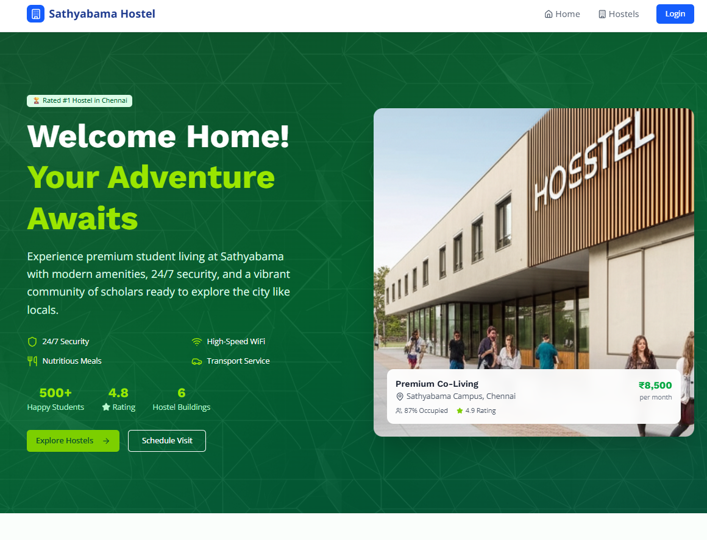
Sample OutPut(screenShort)

Slide 14
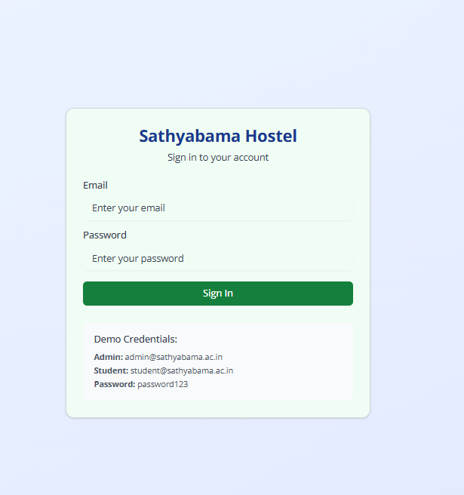

Slide 15
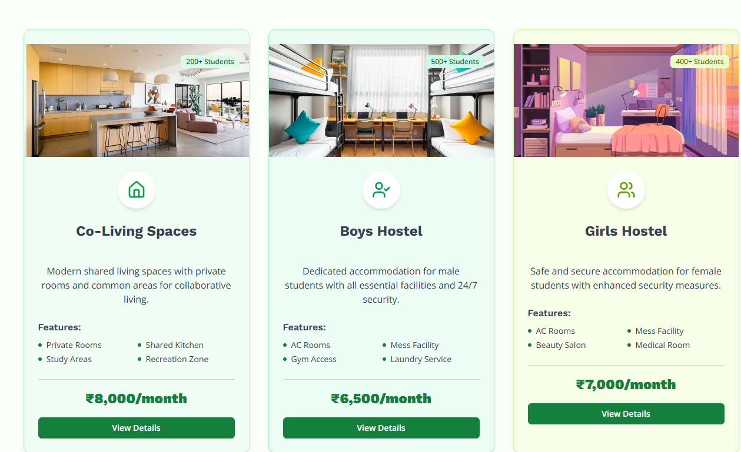

Slide 16
Conclusion
The Sathyabama Hostels Management System delivers a comprehensive, efficient, and user-friendly platform that benefits administrators, students, and the institution as a whole. This project is ready for implementation.

